Slide 1



Introduction to IOT
Training Presentation

Slide 2
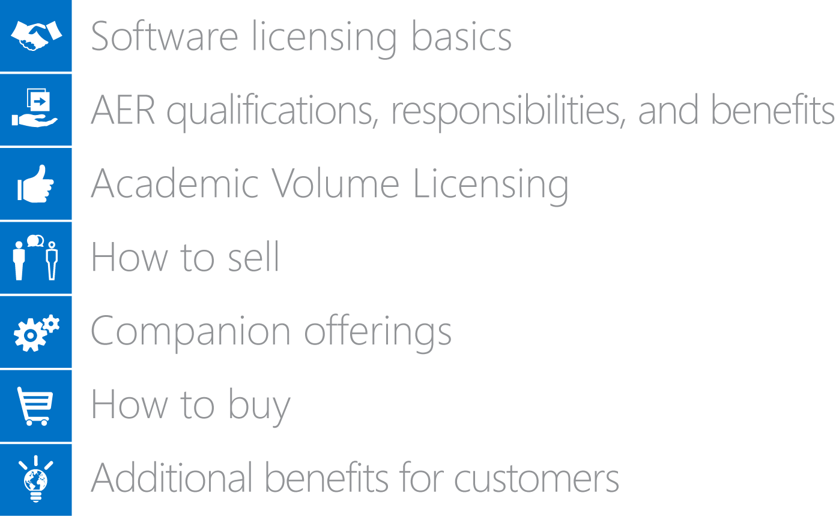
Topics
Introduction to IOT
What is IOT
Devices and Technology
Understanding of IOT
Growth and Examples

Slide 3

Introduction to IOT

Slide 4
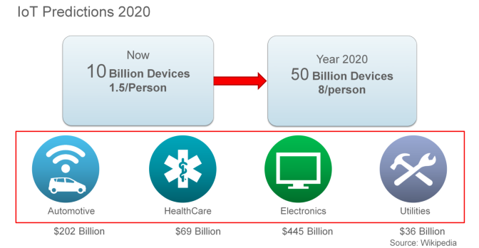
IOT Prediction

Slide 5
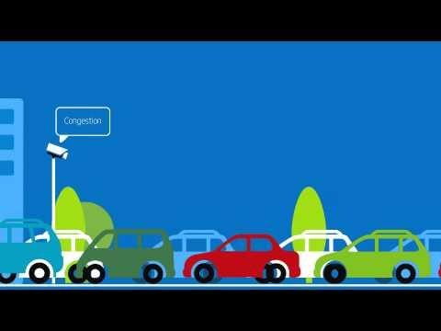
What is IOT ?
Introduction
Example
IoT is very broad, not contained to a single technology.
It does not matter what you use, it is important how you use it.
Internet is the keyword in the internet of things. Communication is the most important aspect of it al.

Slide 6
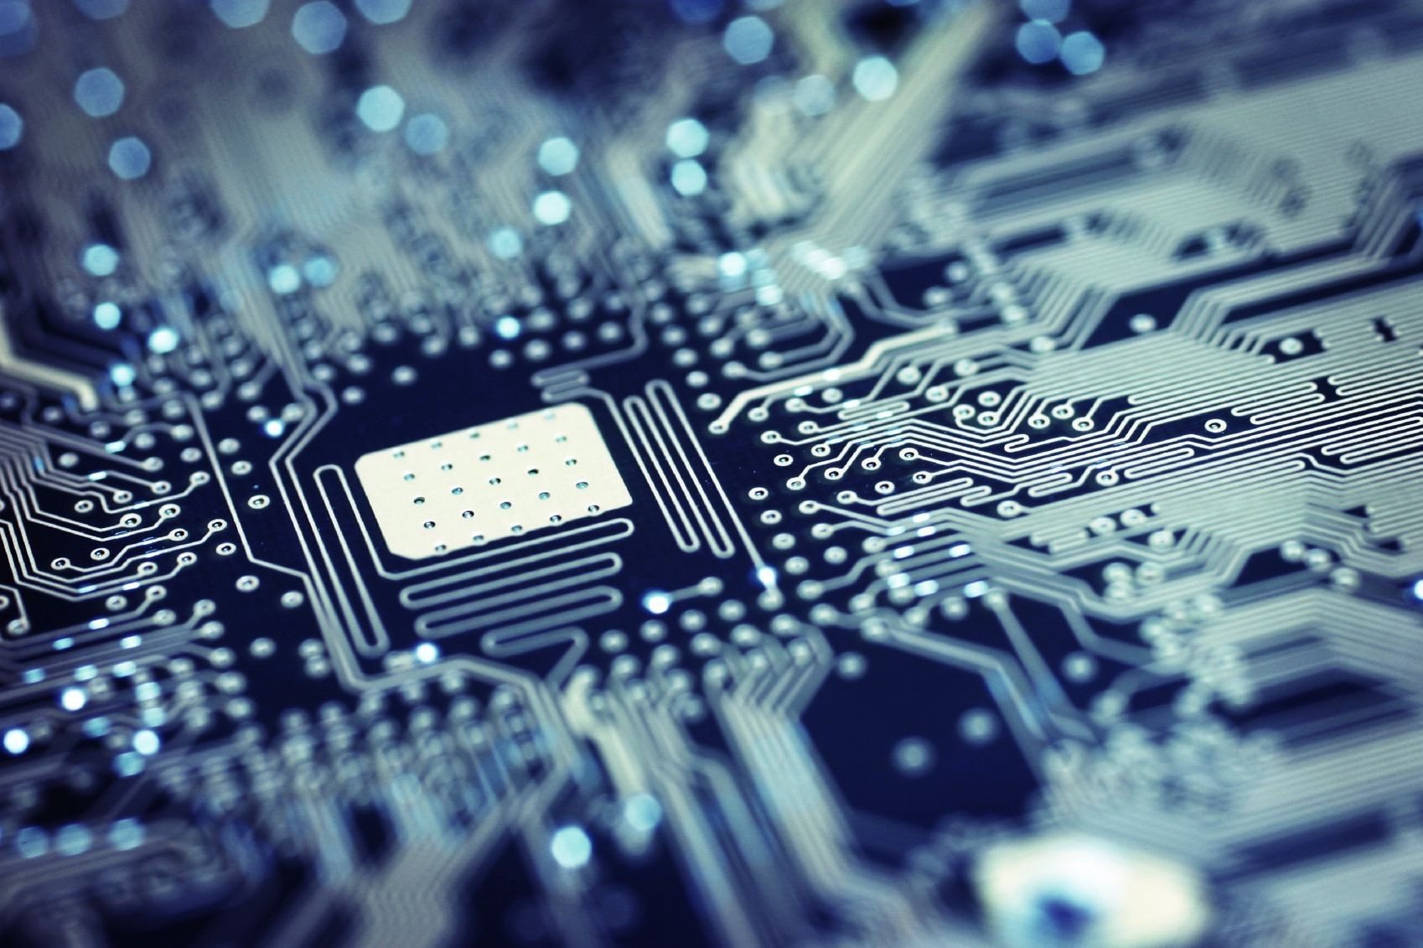
Technology

Slide 7
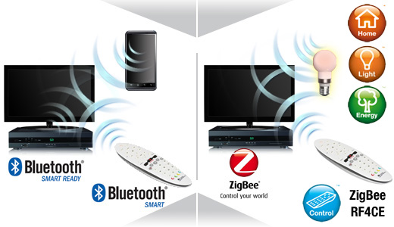
Technology
Devices
Example
BlueTooth Low Energy
WiFi
RF
Distributed computing
Mesh networks
Java / javascript / .net / rails / … / C++ / C / …
Analog & digital electronics

Slide 8
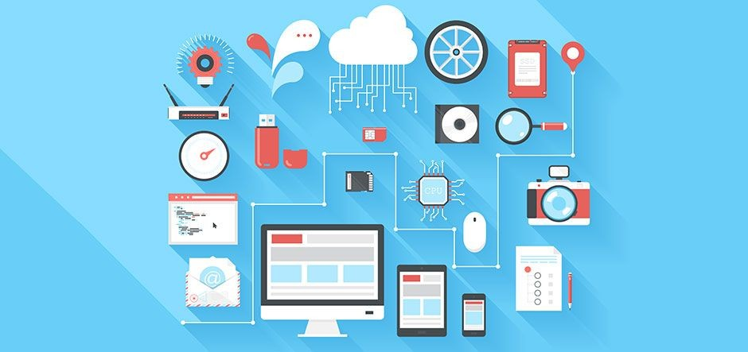
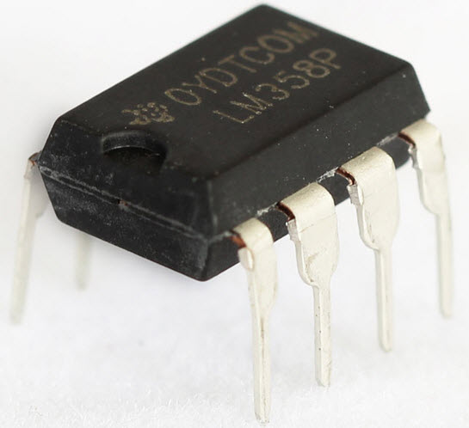
Devices
Other Options
Arduino
Raspberry Pi
Intel Edison
Tessel.io
Particle.io (Spark Core, Photon & Electron)
ESP8266 (12E)
BeagleBone

Slide 9
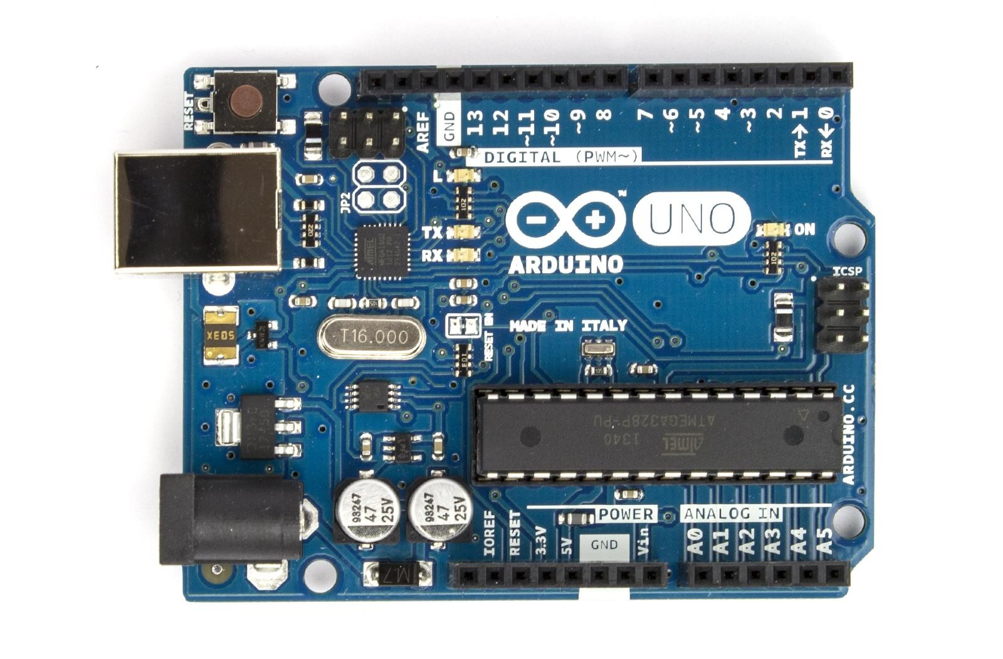
Arduino

Slide 10
Arduino
Introduction
Example
Prototyping
Language: Arduino (based on C/C++)
Storage: 32KB flash
Different models (Uno, Due, Mini, Nano, …)

Slide 11
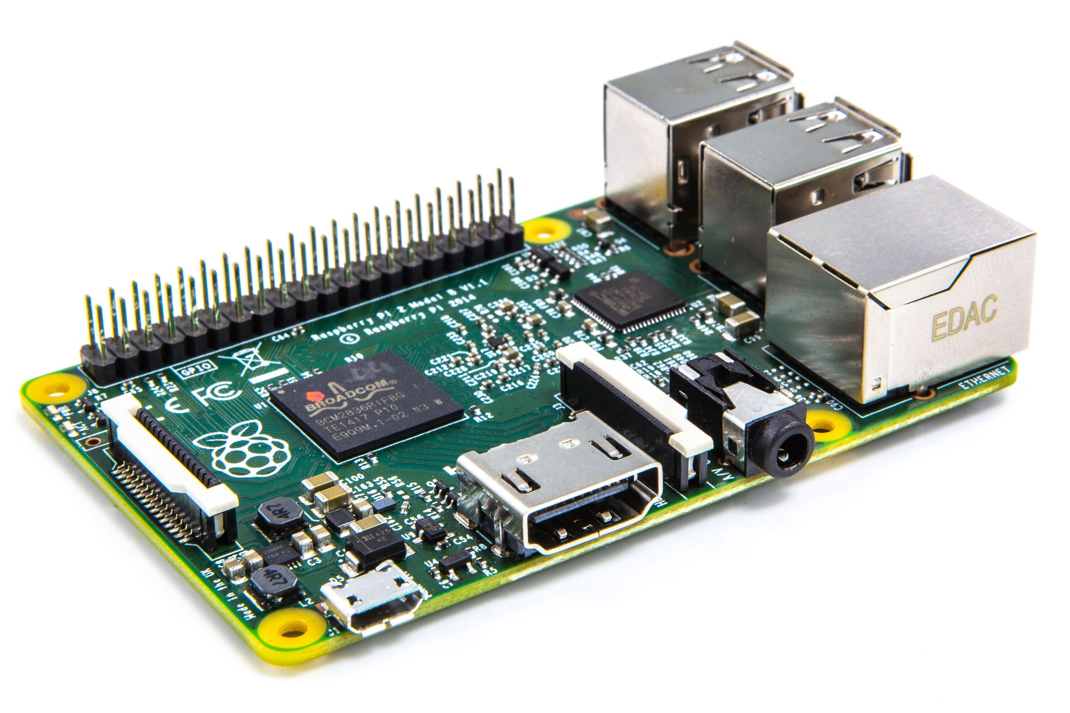
Devices - Raspberry Pi

Slide 12
Raspberry Pi
Introduction
Multiple use cases, mostly for digital signage or as mediaplayer
Language: Java, Javascript, PHP, Ruby, …
Storage: SD card (OS) or external HDD (USB)
Different models (A/B/B+/2)
Example

Slide 13


Slide 14


